Slide 1


SMART INDIA HACKATHON 2024
TITLE PAGE
Problem Statement ID – 1558
Problem Statement Title - Al-based automated defective exhibit identification system placed in a gallery.
Theme - Smart Automation
PS Category - Hardware
Team ID -
Team Name - Frame Fixers

Slide 2
AI-Based Automated Defective Exhibit Identification System
Frame Fixers
Solution Overview:
The AI-based automated defective exhibit identification system enhances gallery management by integrating high-resolution imaging and advanced AI technologies. It automates the detection of defects in exhibits, ensuring efficient and accurate maintenance.
Key Features:
Fully Portable Module: Advances in miniaturized sensors, lightweight imaging equipment, and compact computing platforms have enabled the creation of portable defect detection systems.
AI-Powered Processing:Employs deep learning algorithms(ex CNNs, RNNs)for accurate defect detection & classification.
Consistent Quality: Automation ensures uniform inspection standards and criteria, leading to consistent quality across all products.
Real-Time Data Acquisition: Sensors offer real-time data acquisition, enabling immediate detection and correction of defects.
Versatility:Sensors can be adapted to measure different physical properties and detect a wide range of defects.
Benefits and Innovations:
1.Advanced Machine Learning Algorithms:The use of deep learning and neural networks to analyze complex patterns and improve defect detection accuracy.
2.High-Resolution Imaging Technologies:Development of high-resolution cameras and imaging system for more detailed inspections.
3.Increased Efficiency: Automation speeds up the inspection process, allowing for higher production rates and reducing the time spent on manual inspection.
4.Cost Reduction:Reduced reliance on manual inspection labor and decreased scrap rates lead to cost savings in both labor and materials.
5.Improved Quality Control:Automatic defect detection systems can consistently identify defects that might be missed by human inspectors, leading to higher product quality and fewer defective products reaching the market.
@SIH Idea submission- Template

Slide 3
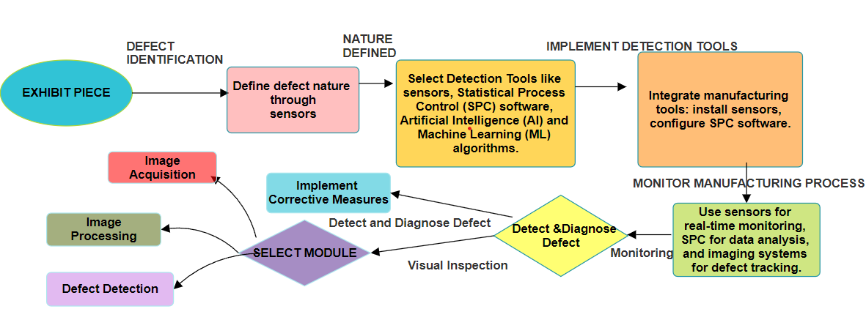
TECHNICAL APPROACH
Frame Fixers
We will employ a range of sensors, including Proximity, Temperature, Vibration sensors, and Ultrasonic sensors for defect detection. For illumination, we will utilize green light within the 510-530 nm wavelength range, positioned between the red and blue spectrums. This green light is particularly effective for inspecting products with red or silver backgrounds, such as sheet metal and machined parts, as it enhances contrast and improves defect visibility, especially against darker surfaces.
@SIH Idea submission- Template

Slide 4
FEASIBILITY AND VIABILITY
Frame Fixers
Technical Feasibility:Technology Availability: High-resolution cameras, advanced AI algorithms, and real-time processing technology are readily available and proven in similar applications.
Integration: The system can be seamlessly integrated with existing gallery management systems. This integration enhances overall functionality without requiring major modifications, thereby preserving the gallery’s current operational setup.
Data Requirements: Adequate data for training AI models can be sourced from historical defect records and existing exhibit images.
Operational Feasibility:
Implementation: The system can be installed with minimal disruption to current gallery operations. High-resolution imaging and AI processing can be seamlessly incorporated.
Maintenance: Regular updates and calibrations for AI models and imaging equipment will be required to maintain accuracy and efficiency.
Economic Feasibility:
Cost: Initial setup costs may include high-resolution cameras, AI software development, and system integration. However, these costs are offset by long-term savings through reduced manual inspection and maintenance.
Return on Investment (ROI): Improved defect detection and proactive maintenance lead to extended exhibit lifespans and reduced repair costs, offering a strong ROI.
Technical Challenges & Strategies to Overcome them:
Hight AI Accuracy: Continuously refine and train AI models with diverse and representative data to improve detection accuracy. Implement robust testing and validation processes to ensure reliable performance.
Training Data:Partner with industry experts and collaborate with other galleries or institutions to expand data sources.
Image Quality and Consistency:Use controlled lighting conditions and high-quality, calibrated cameras. Implement image preprocessing techniques like normalization, enhancement, and denoising to improve image consistency.
Adaptation to New Defects:Continuously update the model with new data and incorporate mechanisms for online learning or incremental updates.
Complexity of Defect Patterns: Employ advanced image processing and machine learning techniques such as convolutional neural networks (CNNs) to capture intricate patterns. Use ensemble methods to combine multiple models for better accuracy.
@SIH Idea submission- Template

Slide 5
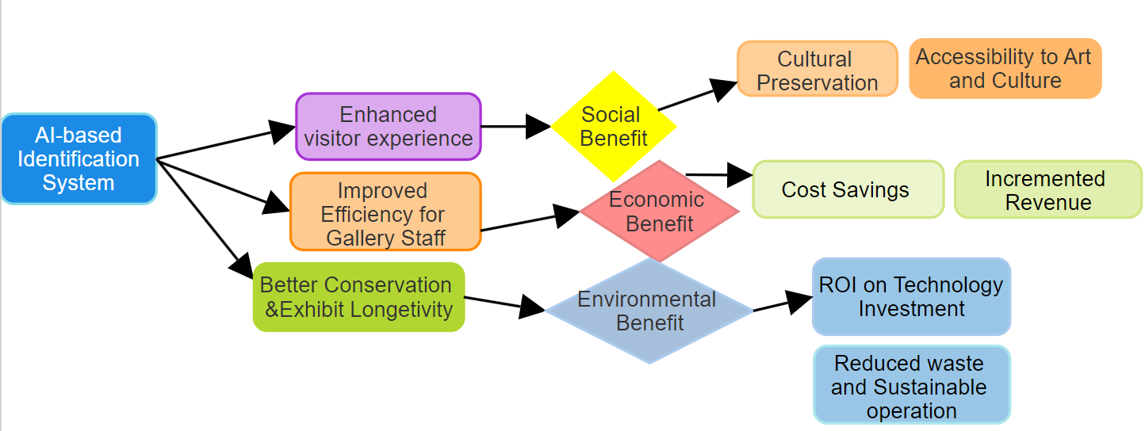
IMPACT AND BENEFITS
Frame Fixers
The AI-based automated exhibit identification system significantly enhances the visitor experience, improves staff efficiency, and supports the long-term preservation of cultural artifacts. Socially, it fosters cultural appreciation, economically, it leads to savings and revenue generation, and environmentally, it promotes sustainability by reducing waste and resource use.
@SIH Idea submission- Template

Slide 6
RESEARCH AND REFERENCES
Frame Fixers
Here are some useful links for research and references related to defect detection in automated systems:
1. Tools and Process of Defect Detection in Automated Manufacturing Systems
[ResearchGate Article](https://www.researchgate.net/publication/374249842_Tools_and_Process_of_Defect_Detection_in_Automated_Manufacturing_Systems)
2. Defect Detection in Manufacturing: Recent Advances
[Springer Article](https://link.springer.com/article/10.1007/s40684-021-00343-6)
3. A Survey on Deep Learning-Based Defect Detection in Industrial Manufacturing
[ScienceDirect](https://www.sciencedirect.com/science/article/pii/S0166361521001154)
4. AI and Automation in Manufacturing Defect Detection
[IEEE Xplore](https://ieeexplore.ieee.org/document/9402227)
@SIH Idea submission- Template

